Slide 1
Bikita minerals Project overview
PRESENTATION OUTLINE
-BACKGROUND
-MINERAL RESOURCES EXPLORATION AND DEFINITION
-EXISTING PLANTS AND OPERATION
-INVESTMENT AND CONSTRUCTION (GRAVITY PLANT FOR PETALITE, FLOTATION PLANT FOR SPOUDUMENE, SMELTER
-PRODUCTION AND PROJECTIONS
-CORPORATE CITIZENSHIP
-CONCLUSION

Slide 2
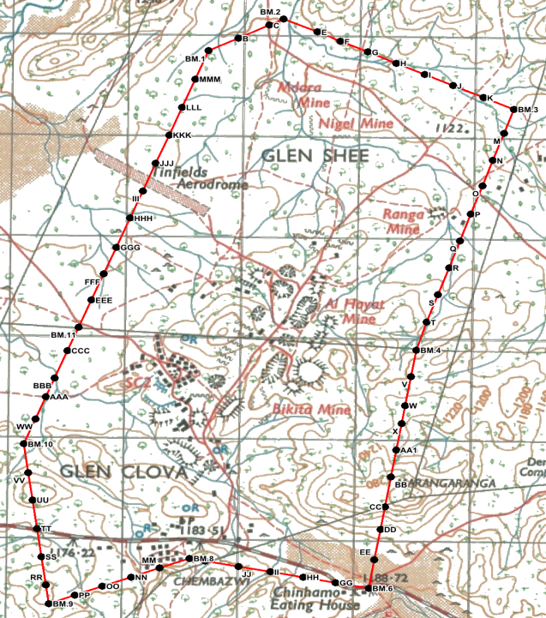
BIKITA MINE LOCALITY MAP
325 km from Harare, 67 km from Masvingo town.
Fully serviced with power (+ standby generators), water, cell reception, FO internet.
Mining Lease (valid):
ML-No.1. 31st August 1963.
1,539 Ha (15.4 km²).

Slide 3
Bikita Minerals
BACKGROUND
Bikita Minerals is an old mine established 100 years ago
The mine has changed ownership over the last 50 years and in 2022 Sinomine acquired Bikita Minerals from AMMS for USD 180 million
Sinomine acquired the mine when it was actually going towards the end of an ore body
Sinomine has invested over USD 300 million towards exploration work and expansion
Bikita Minerals mining lease covers 15.4 square kilometres
We have an estimated 65.42 million tonnes resource estimation

Slide 4
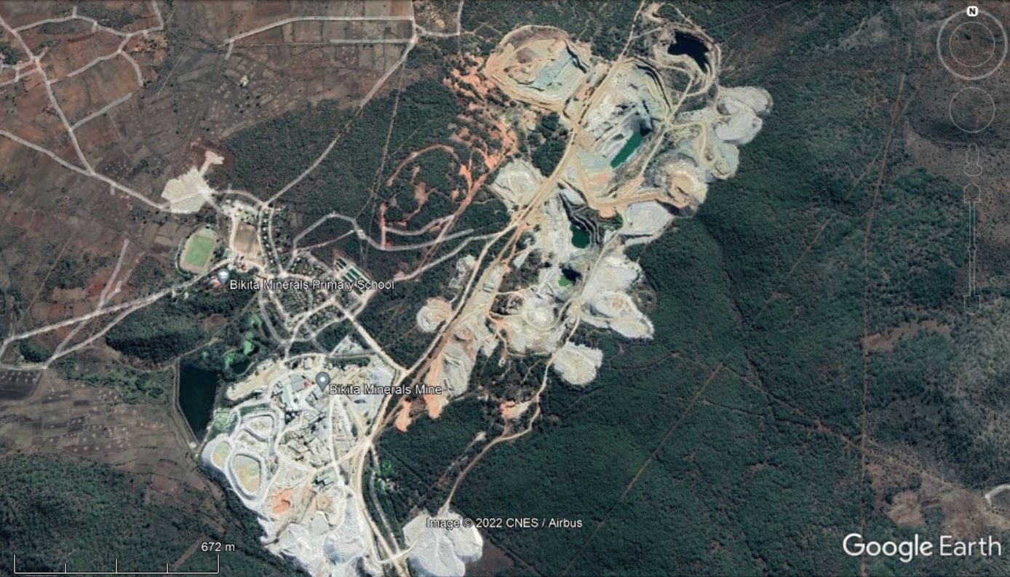
GEOLOGY PRESENTATION
BIKITA MINERALS MINE PITS AND PLANT
OVERVIEW

Slide 5
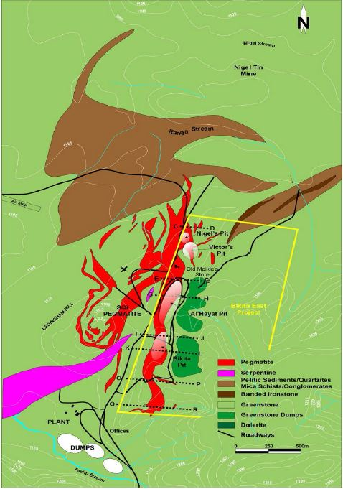
EXPLORATION
Exploration for Bikita pegmatites was first recorded in 1911.
Drilling being done by ox-wagon type drills.
The pegmatites are emplaced in partly greenstone and metasediments.
Bikita deposit is known as lithium-ceasium-tantalite (LCT) bearing type.
Current exploration has been at Ledingham Hill SQI6 as well East of the main pegmatite which include the Bikita Pit, Al Hayat Pit and McMurdon area.
Exploration holes were also drilled further north at Dam site and Mauve Kop.

Slide 6
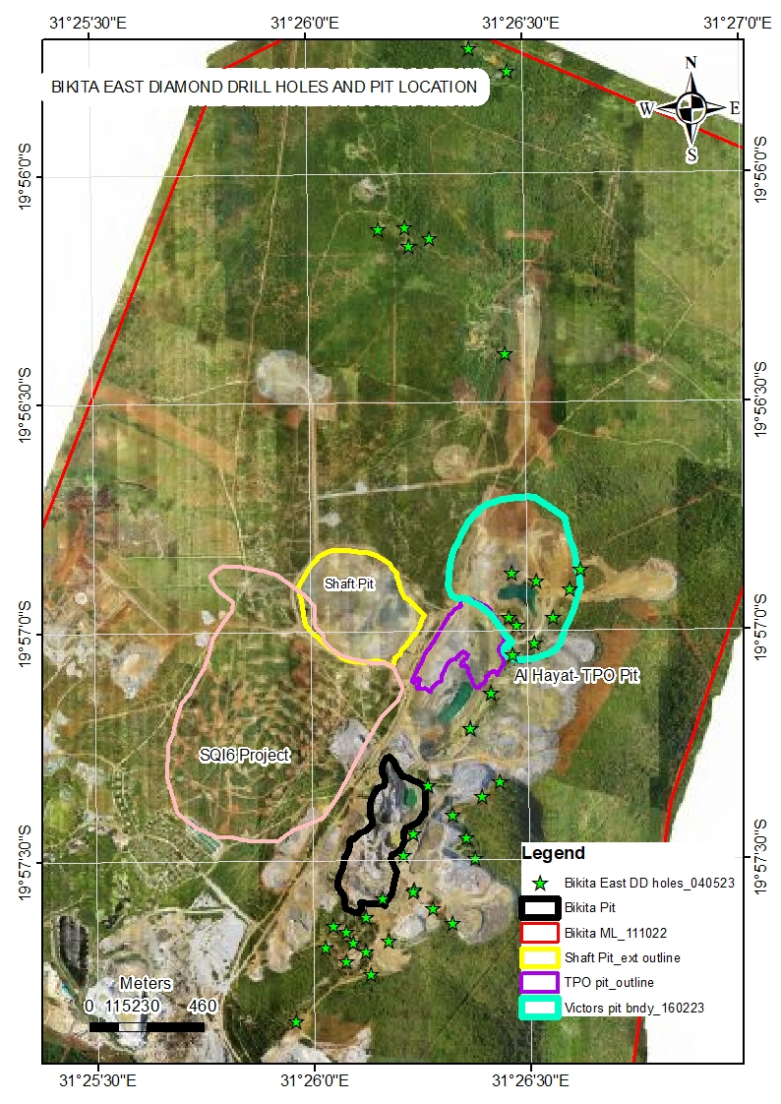
EXPLORATION – Bikita East Diamond Drill Holes and Pit Location
Estimated Resource: 65.42 million tons
AREA | DDH | （m）
SQI6 | 156 | 20565.79
East & South of Bikita South | 43 | 7014.35
Mauve Kop | 4 | 210.90
Damsite | 2 | 96.70
Cumulative Total | 205 | 27887.74

Slide 7
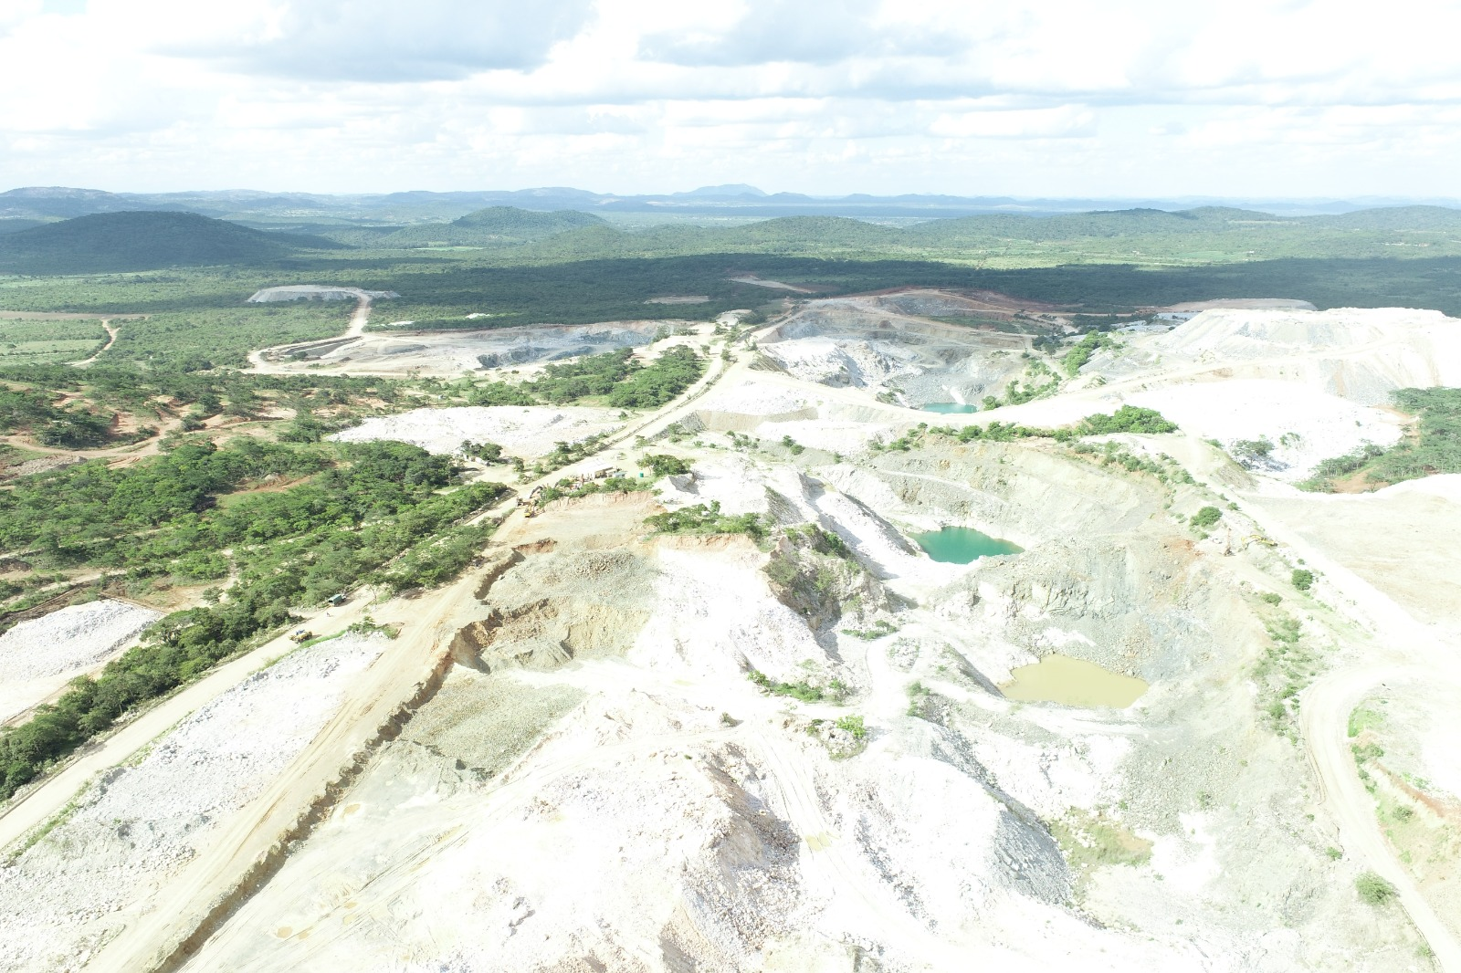
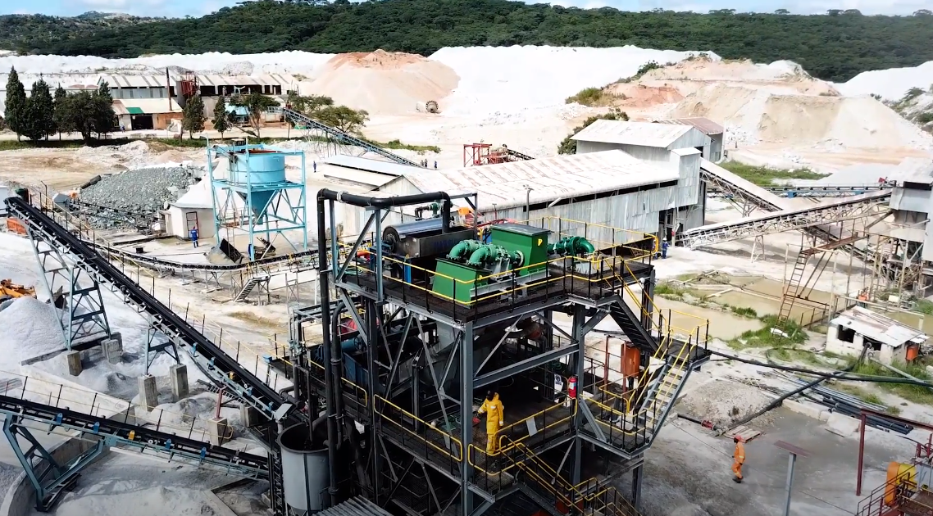
Existing plant AND operation

Slide 8
Improvements and Development Mining activity and Old Gravity Separation Plant
Increased production from 500 000tons to 2 000 000tons per month
Improved optimised throughput of the old crushing plant by 24%
Increased DMS throughput from <70tph to >100tph)
Recovery of low quality ores and tailings
Equipment modifications and improved maintenance systems

Slide 9
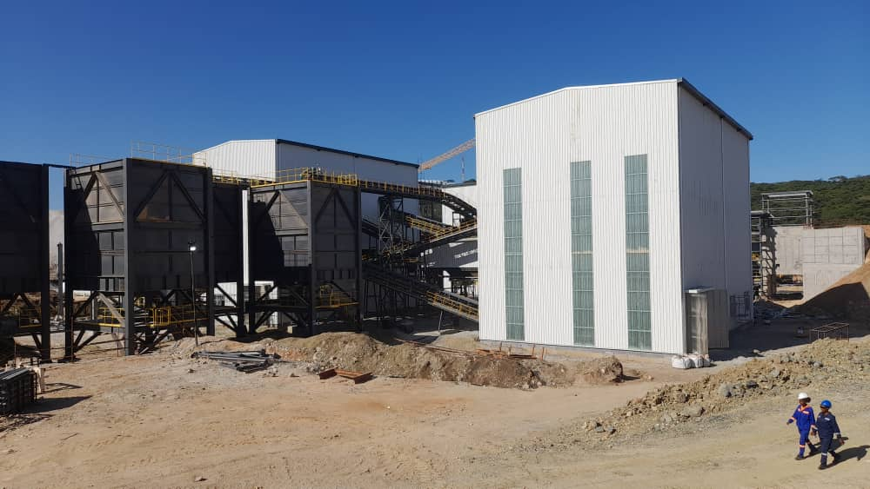
New Gravity Separation Plant
New Crushing Circuit
Crushing Capacity : 200tph
Feed size range : +0.300mm (To gain 10 to 15% yield margin increase ,against Old plants which cuts at 0.850mm )
Production : 480,000TPA
Project Status
Crushing section 100% complete- (Test runs in progress)
95% complete
ETC – July 2023
DMS Circuit (3,4 ,5,6 and 7 subunits)
Expanded tailings handling system

Slide 10
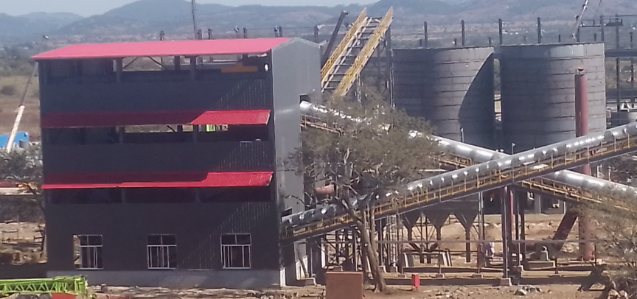
New Spodumene Project (Flotation Separation Plant)
Simplified flow sheet
Average product grade : 5.0-5.5% Li₂O
Processing Capacity capacity : 330tph
Annual Production target : 250,000TPA (Spodumene concentrate)
Project Status :
70% - 80% Complete
ETC – July 2023

Slide 11
Smelter Plant
Feasibility Studies ongoing, Establishment plan on cards
Expected to start mid 2023
KEY DELIVERABLES
Optimised extraction
Improved beneficiation
Economic growth
Construct power and acid plants

Slide 12
Production and Projections
Current Production- 10 000ton per month (3.9% LiO)
New DMS Plant online-30 000tons per month (3.9% LiO)
New Spodumene Plant online-20 000tons per month (5% LiO)
Project Plan - Critical Path
Old Plants Optimised Capacity
New DMS Plants online
New Spodumene Plant online

Slide 13
EXPECTED REVENUE
2023 Expected Revenue- USD 500 000 000
2024 Expected Revenue-USD 600 000 000
2025 Expected Revenue-USD 800 000 000
Revenue accrued to Government (taxes, royalties, duty)- Approximately 35% of attained revenue

Slide 14
Corporate citizenship
Employment- Currently we employ 860 employees from 360 employed in 2022.
- An additional 800 expected to be employed on completion of the two new plants.
- Our contractors employ about 1200 (80% are locals)
Employee welfare-The company provides accommodation to 600 mine employees and planning to acquire land from Bikita RDC.
-We have a state of the art primary school and clinic catering for the employees children and surrounding communities.
- In addition we sponsor Bikita Minerals FC in the Eastern Region Division One
Local Community-Constructed Shumbaimwe Clinic
- We have set up a Community Share Ownership fund administered by Chiefs
-Construction and rehabilitation of all roads in the district,
-Constructed and refurbished (4) schools in the district and distributed food and learning material to (8) schools.
from poor backgrounds is in place

Slide 15
Corporate citizenship(continued)
Local community -Constructed and refurbished (4) schools in the district and distributed food and learning material
-Bikita Minerals drilled 13 boreholes for the community.
National Projects- Bikita Minerals is constructing a 130km 133/34 KVA powerline (Tokwe-Bikita) at total value of USD 20 million.
-An additional USD 2 million has been set aside for rural electrification program covering (Gutu, Zaka and Bikita).
-USD 6 million has been budgeted for the construction of the Birchenough bridge.
-A tertiary Scholarship fund to assist talented students from poor backgrounds is in place

Slide 16
Conclusion
-As Bikita Minerals we aspire to be the third best Lithium mine in the world on completion of the two new plants under construction.
-We want to continue to invest in exploration and new mining development
-We continue to focus more on value addition and beneficiation
To achieve this, we need to address the following issues:
A common national vision
Policy consistency
Enhanced Government support to facilitate the ease of doing business

Slide 17
(Thank you) 谢谢

