Slide 1
Supported by: Current Membership Ministry of Energy and Power Development ZETDC Ministry of Finance and Economic Development GreenCo - Zambia Zimbabwe Energy Regulatory Authority (ZERA) ZESA Holdings (Private) Limited

Slide 2
Board of Directors
Mr. E. G. Cross – Chairman
Mr A. Mhembere – Platinum Producers Association
Mr C. Dengu – RioZim
Mr T. Barnard – Prospect Lithium Zimbabwe
Mr B. Xu – Afrochine Smelters
Mr K. Matsheza – CZI President
Mr C. Mangezi – Blanket Mine

Slide 3
Background
The large industrial and mining energy users require a long-lasting mitigation measure to power supply challenges.
With the support of the Government of the Republic of Zimbabwe the large industrial and mining energy users have formed a group called Intensive Energy User Group (IEUG) with an objective to pool financial resources towards financing the procurement of electricity from within SADC, including local generating companies, at competitive tariffs.

Slide 4
What is the IEUG?
The IEUG is a Not-For Profit voluntary organisation whose mandate is to pool financial resources and procure reliable, predictable and uninterrupted base load electricity electricity from external and local generating companies at competitive tariffs.
IEUG is not a competitor to ZETDC
The IEUGZ works closely with ZETDC in the sourcing, evacuation and delivery of electricity to the IEUG members

Slide 5
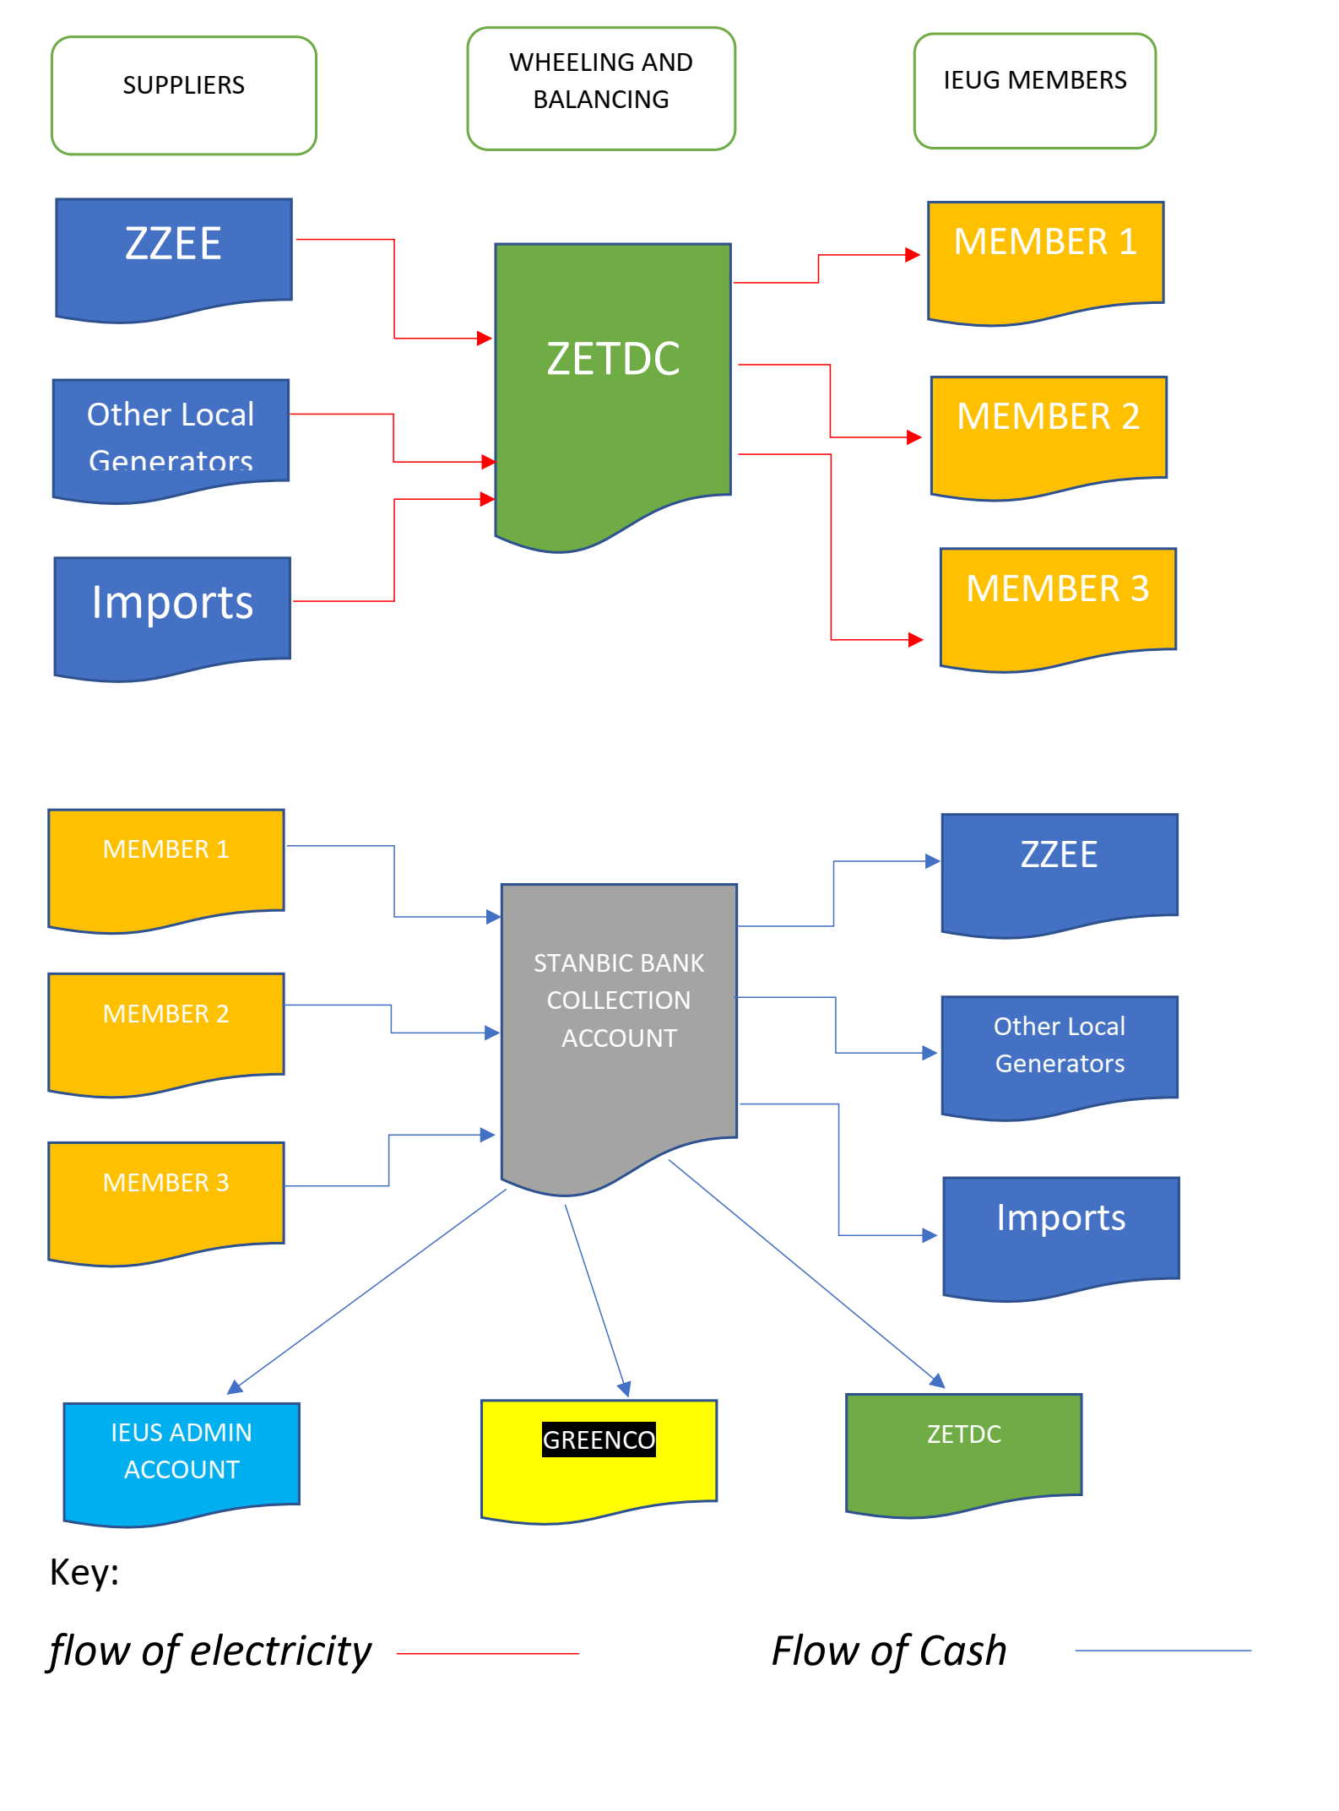
IEUG Base Load Supply Model

Slide 6
Operational Status
IEUG commenced operations on 01 April 2023 with a base load supply of 40MW secured from Zimbabwe Zhongxin Electrical Energy (Private) Limited (ZZEE).
The power supply agreement (PPA) with ZZEE is for an initial term of 5 years at a fixed tariff.
ZERA has approved a wheeling tariff of USc1.25/kWh payable to ZETDC. The wheeling charged will be reviewed annually.

Slide 7
Operational Status Cont..
IEUG is in the process of finalising a System Operating Agreement (SOA) with ZETDC.
The SOA governs the terms and conditions for balancing the electricity secured by IEUG to guarantee a reliable, predictable and uninterrupted supply to IEUG Members.

Slide 8
Requirements to withdraw IEUG power
The IEUG member must have a dedicated feeder power line.
The IEUG member must have a Smart Meter (as prescribed and installed by ZETDC).
The IEUG Member must be cleared and assigned to withdraw power from the IEUG by ZETDC

Slide 9
The IEUG Investment Program
Zimbabwe has a 800 megawatt deficit in power supplies. This is equal to 40 per cent of demand and we will not be able to overcome this shortage for 5 years until new power becomes available.
This problem is compounded by the fact that energy demand in Zimbabwe is increasing exponentially and is expected to reach 10 000 megawatts by 2030. The Mining Industry is the main driver.
IEUG is supporting the listing of ZETDC on Victoria Falls Stock Exchange to raise money to invest in the Grid and transmission Infrastructure. The need for a robust grid and transmission infrastructure in critical to the national development

Slide 10
The IEUG Investment Program
Supported by Members current and projected demand for power, a Group Bankable Power Purchase Agreement is being used to raise international financing for regional power projects.
A typical example is the new power plant at Mphanda Nkuwa on the lower Zambezi where IEUG has entered into an agreement to take 1000 megawatts of power at a delivered price of 6,8 cents per kWh.

Slide 11
IEUG Investment Program
The following regional projects are planned: -
Mphanda Nkuwa 1500 megawatts
Kariba Floating Solar Farm 250 MW (phase 1)
Cahora Bassa Expansion 1200 megawatts
Chemba 1 and 2 2000 megawatts
Batoka and Devils Gorge 3000 megawatts
Domestic Solar 2000 megawatts
Domestic Coal Fired IPP 8000 megawatts

Slide 12
IEUG Investment Program
The above program will be supported by major investment in natural gas fired plants in Zimbabwe and Mozambique.
Transmission and Distribution
No significant investment has taken place in the regional and domestic power transmission and distribution system. Plans are being made to support a ZETDC Program to invest US$3 billion in the next 5 years.

Slide 13
Conclusion
The IEUG has secured 600 megawatts of power supplies from regional and domestic producers.
This resource is sufficient to supply the majority of our existing mining industry with uninterrupted power.
We are now taking on larger industrial consumers.
Our investment program will accommodate growth in demand going forward.

Slide 14
Contact Details for Further Information
Email – info@ieug.org.zw
trading@ieug.org.zw

Slide 15
THANK YOU

