Slide 1
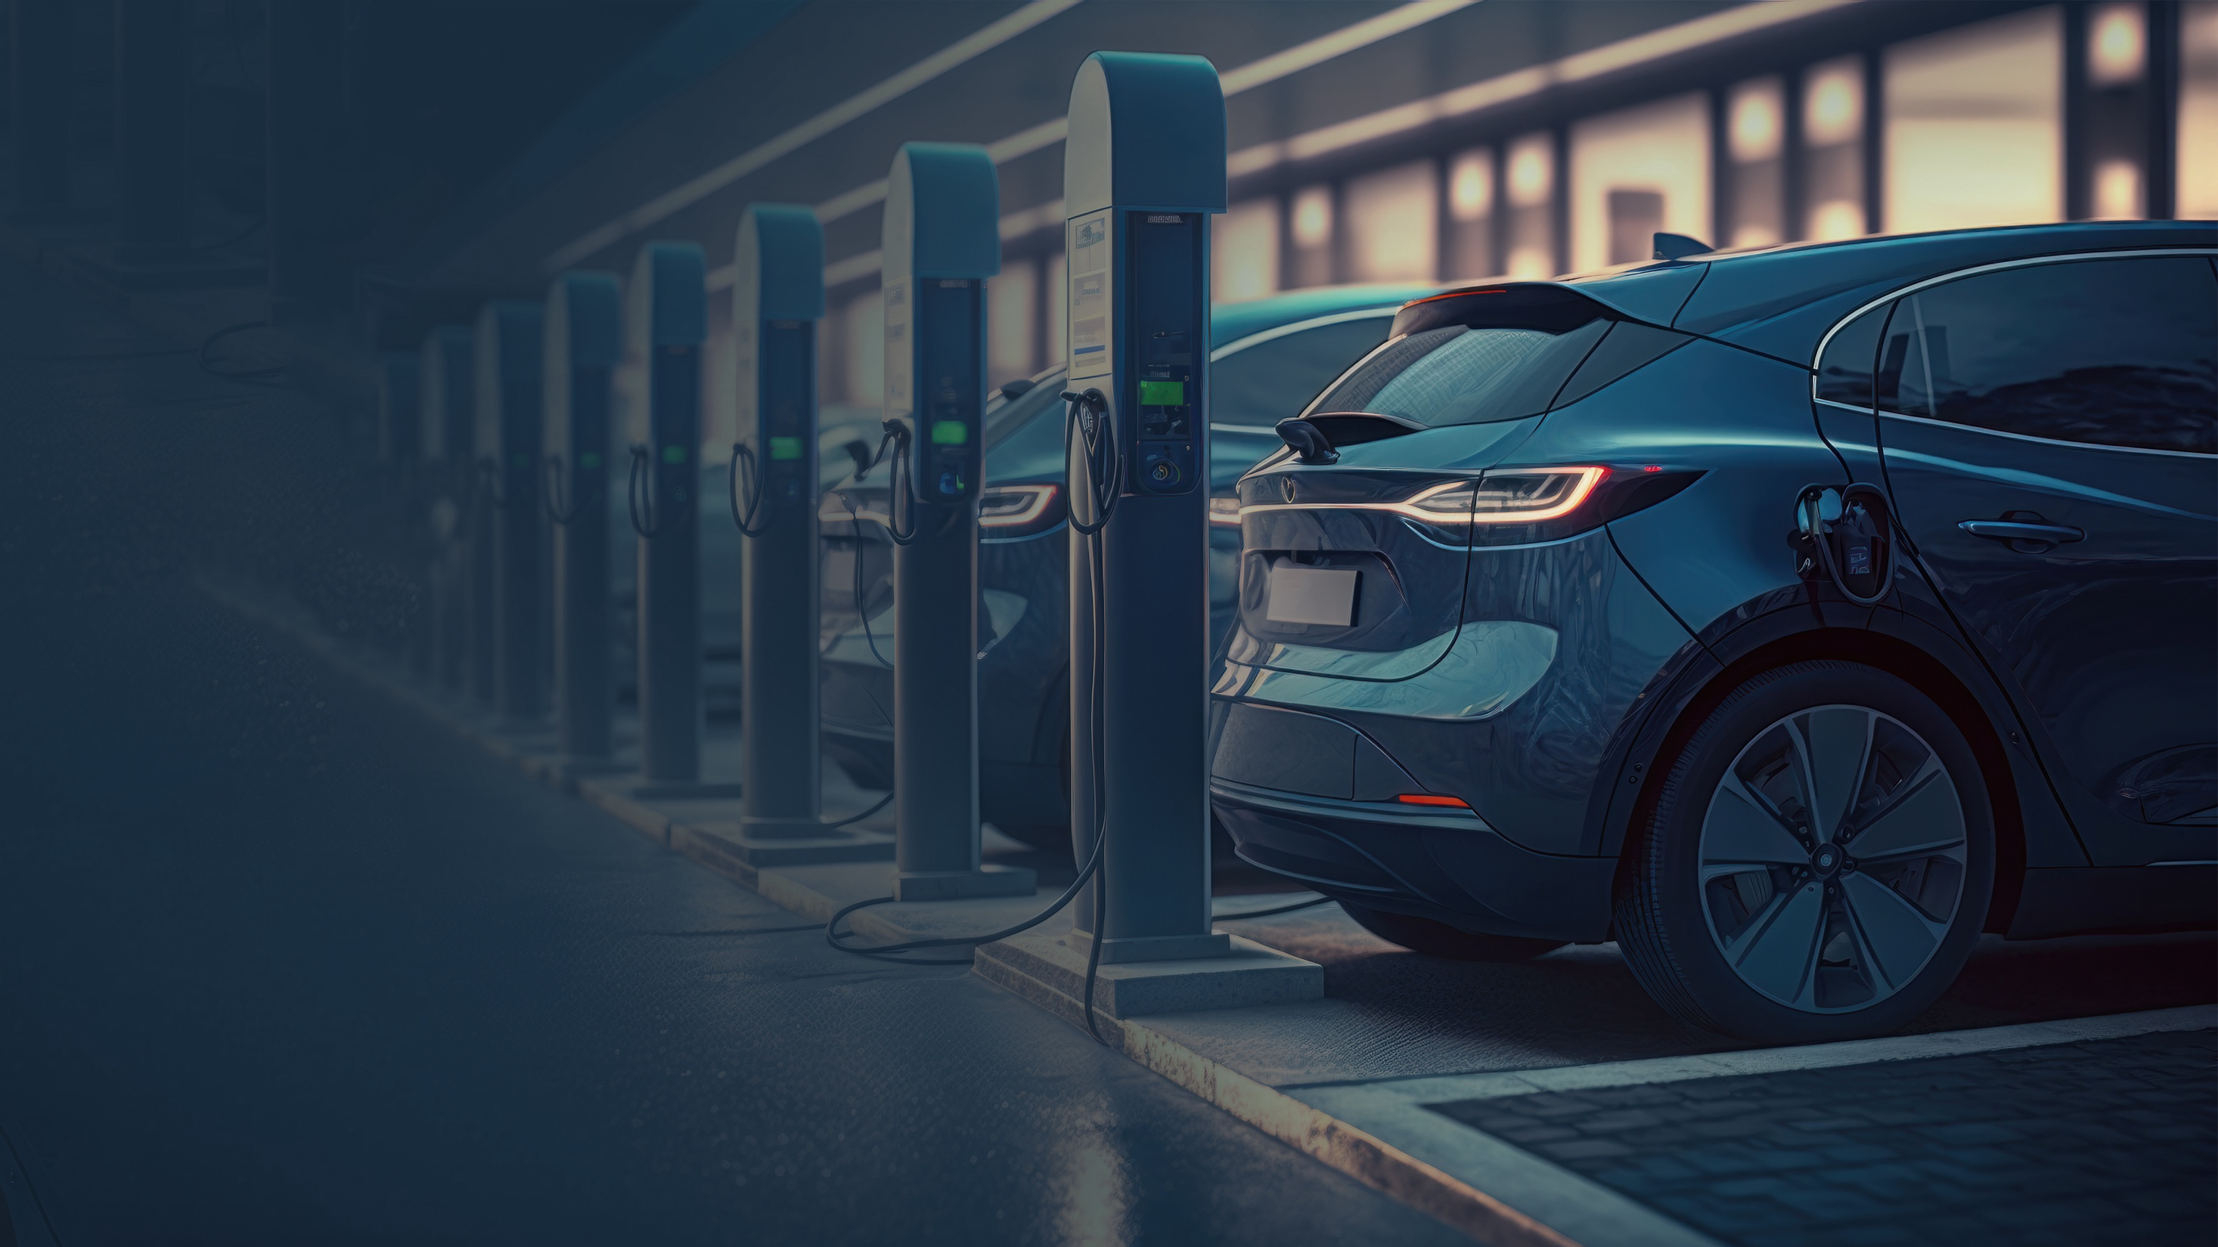
Hatch presents: Developing Battery Minerals Value Chain – Global Experiences and Best Practice
May 31st, 2023
The Chamber of Mines of Zimbabwe 2023 Annual Mining Conference, Exhibition and AGM
Unleashing the Growth Potential of the Battery Minerals Value Chain Symposium
Victoria Falls, Zimbabwe
Copyright © Hatch 2023. All Rights Reserved.

Slide 2
Agenda
01
Growth and Constraints
02
Reimagining the Battery Minerals Value Chain
03
Key Success Factors
Copyright © Hatch 2023. All Rights Reserved.
2

Slide 3
Electric vehicle sales are forecast to grow faster than internal combustion engine vehicles
Electric vehicle sales forecast (million vehicles)¹
Internal combustion engine vehicle sales forecast (million vehicles)²
US
73
83
US
Europe
70
82
80
79
Europe
China
64
67
77
74
China
Rest of the World
61
70
Rest of the World
58
66
63
55
60
51
57
48
54
51
44
49
47
46
40
45
43
36
32
24
27
21
14
17
’23
’24
’25
’26
’27
’28
’29
’30
’31
’32
’33
’34
’35
’36
’37
’38
’39
’40
’23
’24
’25
’26
’27
’28
’29
’30
’31
’32
’33
’34
’35
’36
’37
’38
’39
’40
Rapid compounded annual growth of 10% for electric vehicle sales.
Sources: 1. BloombergNEF, 2. Woodmackenzie 3. Hatch Analysis

Slide 4
This pattern triggers a demand in lithium-ion batteries projected to grow at a CAGR of 14%
5,306
E-buses
Electric two/three wheelers
4,983
Consumer electronics
Commercial Evs
4,583
Stationary storage
Passenger EVs
4,233
3,859
+14%
3,483
Lithium-ion battery demand (GWh/year)
3,033
2,621
2,259
1,859
1,459
1,059
1,122
2023
2024
2025
2026
2027
2028
2029
2030
2031
2032
2033
2034
2035
Source: BloombergNEF. The barrel of tomorrow, January 2023

Slide 5
Consequently, the demand in battery metals is projected to grow at a CAGR of 24%
Manganese
Graphite
Aluminium
18
Phosphorous
Nickel
Copper
Iron
Lithium (LCE)
16
14
12
+24%
10
Demand in million metric tonnes
9
8
6
4
3
2
2020
2021
2022
2023
2024
2025
2026
2027
2028
2029
2030
Source: BloombergNEF. The barrel of tomorrow, January 2023

Slide 6
Agenda
01
Growth and Constraints
02
Reimagining the Battery Metals Value Chain
03
Key Success Factors
Copyright © Hatch 2023. All Rights Reserved.
6

Slide 7
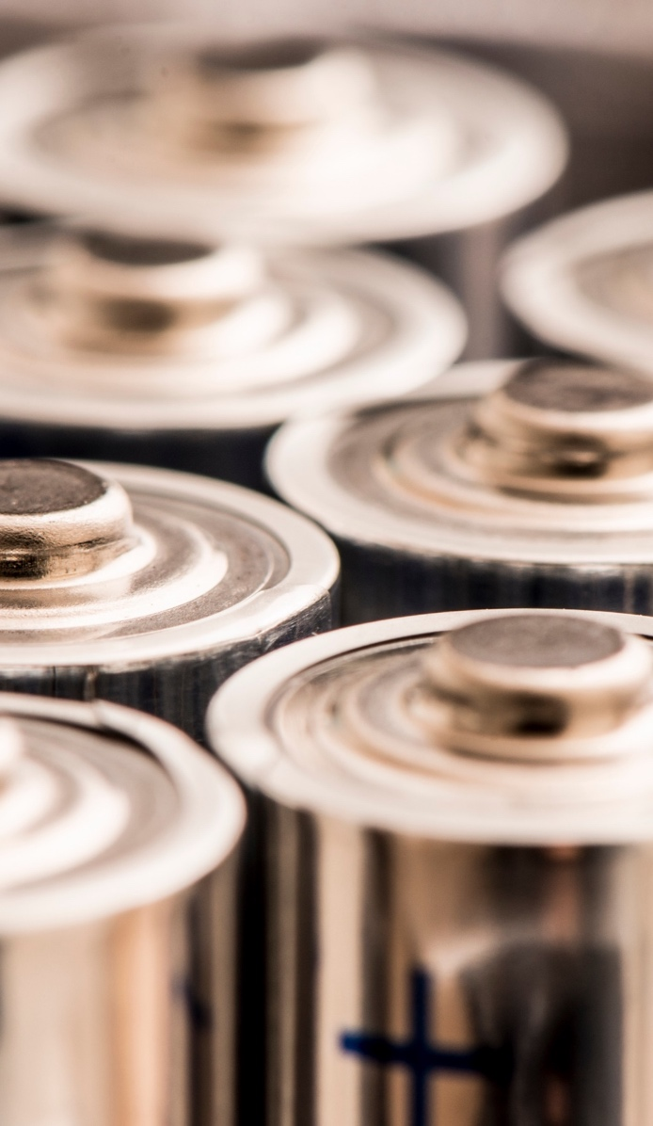
Africa has a role to play in the battery metals market as it holds some of the key ingredients for the LIB value chain
African reserves & resources* (in mt)
% Of world resources
Cobalt
15
51%
Africa hosts a variety of mineral resources that are crucial to the LIB sector. It outranks any other continent in abundance of
Copper
230
7%
Graphite
460
74%
Cobalt
Lithium
11
5%
Graphite
Manganese and,
Manganese
2600
54%
Phosphate rock
Nickel
32
8%
Phosphate
47500
55%
Source: Hatch, S&P Global
Notes: *Contained Amount as of Feb’2023

Slide 8
Currently, the continent has established industrial centers where these metals and minerals are converted into intermediate and final products
Africa’s refinery production (in kt)
As % of world production
4.3
1540
-
Cobalt*
Copper*
Graphite
3%
6%
-
-
30
39
Lithium
Manganese**
Nickel*
-
5%
2%
8730
Phosphate***
19%
Source: Hatch, S&P Global, BGS, USGS,IFA, IMnI
Notes: *as of 2020 **as of 2022 ***as of 2021
Phosphate
47500

Slide 9
However, the surge in demand presents supply chain issues due to lead times associated with the value chain of the battery minerals
Stage completion requirements
The longest lead times are in the development of primary LIB material sources, due to:
Years
Mining*
7-14
1-2
1-2
2-5
1-3
20
Smelting & Refining
Cyclicality of metal prices and exploration spending
Concentration of mineral resources in volatile political regions
Low exploration success rate (1 mine out of 100 discoveries)
1
2-5
10
pCAM
6
Ever increasing regulatory requirements (ESG, permitting)
Test-work for and development of projects in ever more remote locations takes time
CAM
2-3
7
Battery
7
There is an inherent disconnect between upstream and downstream project delivery timelines, as well as their respective flexibility in product specs
exploration
feasibility
construction
prefeasibility
permitting
ramp-up
Source Hatch estimates
Notes: *Implies the successful discovery and development of an economic mineral deposit.
Notes:
Downstream facilities are relatively easy to set-up and have shorter time-lines to implement. Their product specs are flexible from the start [NCM622 vs 811], while the same are fixed for mines 4-5 years before start-up → post start-up product spec flexibility for mine are limited (different flow sheet and equipment requirements)

Slide 10
There is an opportunity for the continent to reimagine its role in the supply chain
01
Current value chain
02
Re-imagined value chain
Exploration
Exploration
Mining
Mining
Concentration
Battery Metal Grade Focussed Beneficiation
Concentration
Smelting and Refining
JV/ equity partnership between a mining company and downstream consumer e.g. Automaker
Vertical integration of mining companies
pCAM/CAM
Smelting & Refining
International Metal trader
Batteries
Off take agreements with end consumer
Value addition e.g. Fuel cells from PGMs
Government guarantees and incentives required
Steelmakers
Automakers
Others
Automakers
Notes:
The reimagined value chain comes with market risks as commodities are beneficiated with a target market in mind (Option 1). However, a well tough-out framework can enable a win-win situation for all stakeholders involved.

Slide 11
Example: the nickel flow sheet is quite complex – many paths to make BG Ni sulphate
Ores
Mining & Beneficiation
Processing & Smelting & Refining
First Use
End Use
Laterite ores
Smelting
Ferronickel
Stainless steel
Machinery/ Equipment
OP mining,
Grinding,
Classifying
Nickel pig iron
HPAL
SCRAP
Utensils
Crude Ni sulphate (PGM ref.)
Saprolite
MSP
Hydromet
Refining
Limonite
High Ni alloys
Heap leach
MHP
Construction
Rounds
Batteries & Black mass
Pyro process
Dissolution
Alloy
Cathodes
Concentrates
Powder/briq.
Currency &
Weaponry
Pressure oxidation
BG sulphate
UG mining,
Crushing
Grinding,
Flotation
Matte
Pellets
Sulfide ores
Rechargeable Battery
Electric vehicles & Other uses
Roaster
Smelter
Roaster
NiO
Vapor metallurgy
Natural occurrence
Intermediate products
First use product
End use product
Recycling product
Processing step
Source Hatch

Slide 12
Hatch’s dissolver can short-cut the BG Ni sulphate production process while assuring product quality
Ores
Mining & Beneficiation
Processing & Smelting & Refining
First Use
End Use
Laterite ores
Smelting
Ferronickel
Stainless steel
Machinery/ Equipment
OP mining,
Grinding,
Classifying
Nickel pig iron
HPAL
Nickel oxide
High Ni alloys
Utensils
Crude Ni sulphate (PGM ref.)
Saprolite
Hydromet
Refining
MSP
Hydromet
Refining
Limonite
Heap leach
MHP
Dissolution
Construction
Rounds
Batteries & Black mass
Crystallization process
Pyro process
Alloy
Cathodes
Concentrates
Powder/briq.
Currency &
Weaponry
Pressure oxidation
Matte
Pellets
BG sulphate
UG mining,
Crushing
Grinding,
Flotation
Sulfide ores
Rechargeable Battery
Electric vehicles & Other uses
Roasting
Smelting
Vapor metallurgy
Natural occurrence
Intermediate products
First use product
End use product
Recycling product
Processing step
Source Hatch

Slide 13
There is an opportunity to simplify the Lithium flowsheet and encourage local beneficiation
Exploration
Mining & Beneficiation
Refining & Conversion
First Use
End Use
Pegmatite/Granite
Crushing milling concentration
Calcination roasting
Leaching
Lithium hydroxide
Lithium hydroxide
Other
Technical grade
Coated
Wet
Medicine
(Depression)
Minerals
Industrial grade
Prospecting in hard rock areas
Spodumene
Anhydrous
Battery grade
Petalite
Lepidolite
Technical grade
Lithium carbonatite
Lithium salts
Technical grade
Bromide
Chemical grade
Industrial grade
Hypochlorite
Batteries
High purity
Sulphate
Battery grade
Lithium dihydrogen phosphate
Lithium chloride
Lithium metal
Na ↓
Technical (Na↓)
Na ↑
Catalyst (Na↑)
Polymerization (tyres)
Natural occurrence
Intermediate products
First use product
End use product
Processing step
Optional step
Source Hatch
Notes:
The reimagined value chain comes with market risks as commodities are beneficiated with a target market in mind (Option 1). However, a well tough-out framework can enable a win-win situation for all stakeholders involved.

Slide 14
Agenda
01
Growth and Constraints
02
Reimagining the Supply Chain
03
Key Success Factors
Copyright © Hatch 2023. All Rights Reserved.
14

Slide 15
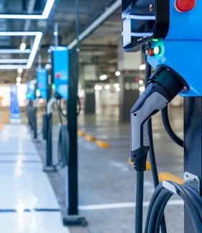
Critical success factors
Abundant, sustainable and affordable energy is essential for redefining sadc’s role in the battery metal supply chain
Improving investor attractiveness at country and regional level
Tailor-made technologies and partnerships with the right global players
Notes:
Abundant, Sustainable & Affordable Energy – microgrids, national grid expansion & integrated regional grids.
Government and private sector to unpack inhibitors.

Slide 16
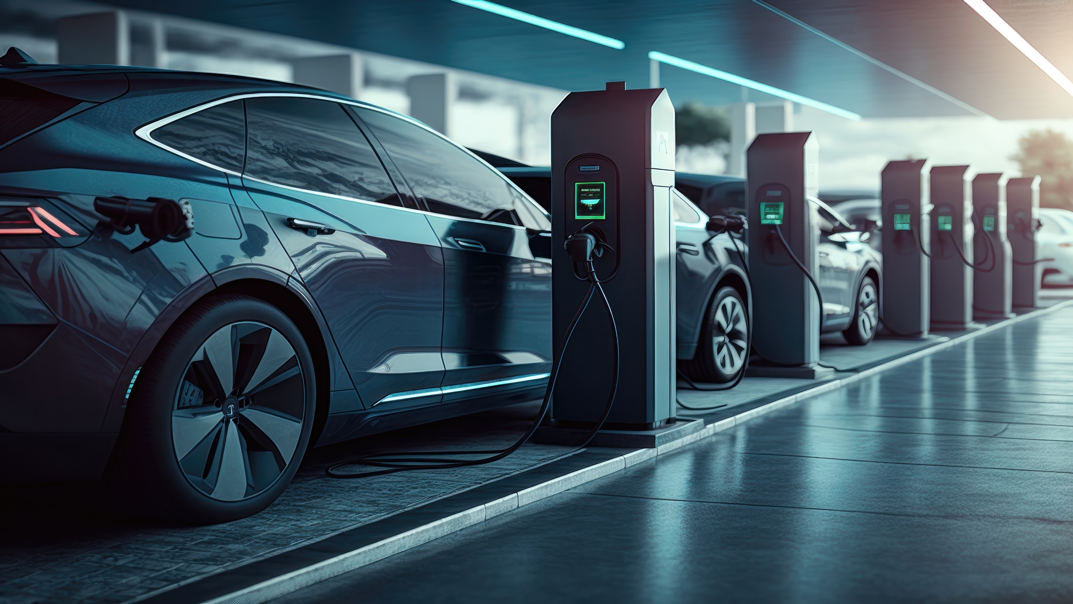
Tailoring technologies and engaging the right global partners should not be an afterthought
Exploration
Business case development
Testwork and process development
Design and project execution
Operation
Site selection
Technology
Flexibility
Market analysis
Demand clustering
Partner selection
Finance structuring
Flowsheet customization
Scaling up
Timing
CAPEX optimization
Supply chain management
Sustainability
Quick ramp-up
Product quality
Adaptability
Copyright © hatch 2023. All rights reserved.
16
Notes:
Technology deployment and customization should be though of right from exploration stage

Slide 17
HATCH has the expertise to help you throughout your entire journey!
Advisory services
Environmental services
Strategy development
Finance structuring
Market analysis
Integrated approach including environmental, community, and social matters
ESG assessments
Test work and commercial capacity scale-up
Digital transformation
Building digital capability in existing operations
Digital twins
Performing and overseeing test-works.
Library of scale-up factors
Process development and optimization
Technology development
Full-scale feasibility
Technology deployment
New technology development
Scaling up
Detail design and project execution
End-to-end design and execution
Designing for sustainability

Slide 18
Thank you
Please contact:
Khutso Sekgota
Senior Principal, Hatch Advisory
khutso.sekgota@hatch.com
Taona Chagwedera
Senior Consultant, Hatch Advisory
taona.chagwedera@hatch.com
Copyright © Hatch 2023. All Rights Reserved.

