Slide 1
Minerals Security Partnership
Nicole Johnson U.S. Embassy Zimbabwe
May 31, 2023
Lithium and Battery Minerals Value Chain Symposium

Slide 2
MSP – Why the need?
Demand for critical minerals driven by the energy transition

Slide 3
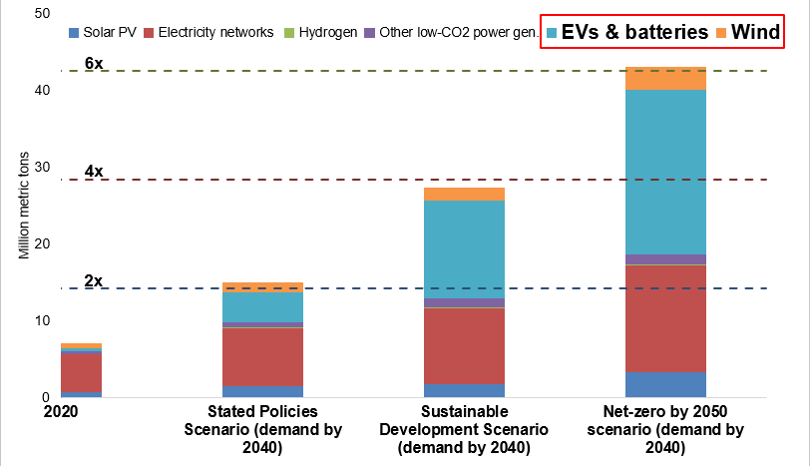
Clean tech: 2x-6x mineral demand by 2040
MSP – Why the need?
Clean tech: 2x-6x mineral demand by 2040
IEA (2021), The Role of Critical Minerals in Clean Energy Transitions, https://www.iea.org/reports/the-role-of-critical-minerals-in-clean-energy-transitions

Slide 4
MSP – Why the need?
Necessity of robust and resilient supply chains

Slide 5
MSP – Why the need?
Top producers’ shares of total extraction of key minerals

Slide 6
MSP – Why the need?
Top producers’ shares of total processing of key minerals*, 2019

Slide 7
Climate Security
Energy Security
Mineral Security

Slide 8
MSP – Why the need?
Market forces alone will not drive necessary changes
Promote high ESG standards
Encourage resource recycling

Slide 9
MSP – Members

Slide 10
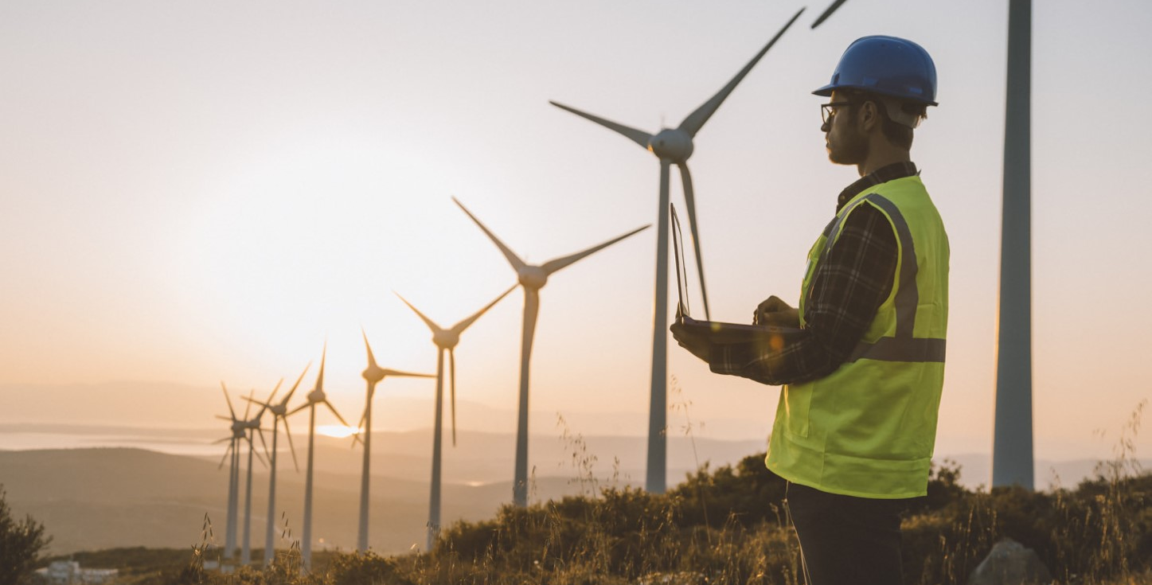
Key Objectives
Attract investment
Increase transparency
Create more options
Promote high ESG standards

Slide 11
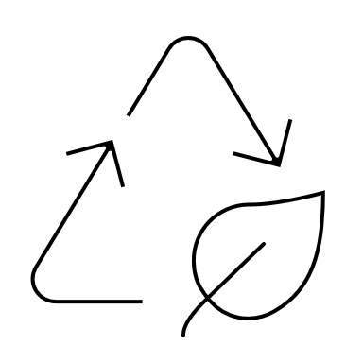
Pillars of MSP
Information Sharing and Cooperation
Investment Network
Promoting Recycling and Reuse
Elevation of ESG Standards

Slide 12
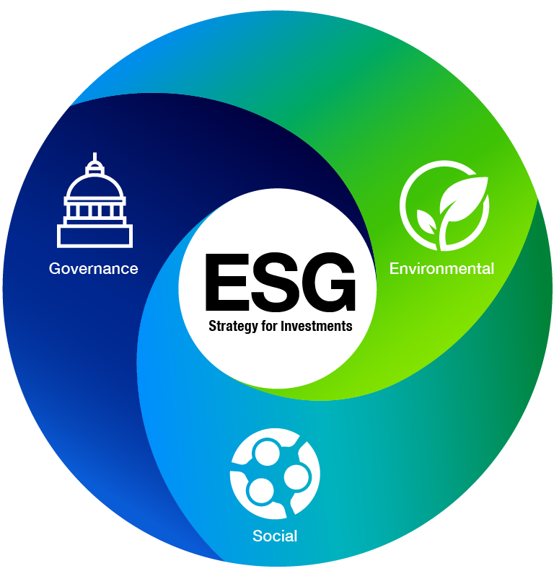
Elevation of ESG Standards
MSP "Principles for Responsible Critical Mineral Supply Chains"
Commitment to High Standards
Social License and Engagement
Good Governance and Transparency

Slide 13
MSP Project Principles
Responsible stewardship of the environment
Consultative and participatory processes
Meaningful engagement and transparent communication
Safe, fair, inclusive workplace conditions
Economic benefit for local communities
Transparent, ethical business operations

Slide 14
MSP

