Slide 1
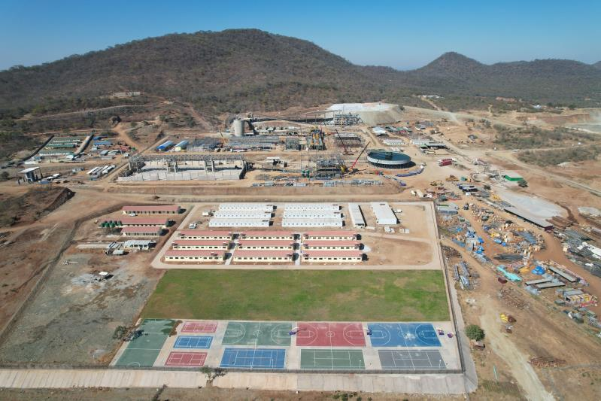

MAX MIND INVESTMENTS (ZIMBABWE)
(PRIVATE) LIMITED
SABI STAR LITHIUM-TANTALITE POLYMETALLIC DEPOSIT – PROJECT SUMMARY
BUHERA DISTRICT – MANICALAND PROVINCE
ZIMBABWE
30 May 2023

Slide 2
CONTENTS
  Project Location & Exploration
  Project Development
  Social Responsibilities
  Strategic Vision
  Challenges and Opportunities

Slide 3
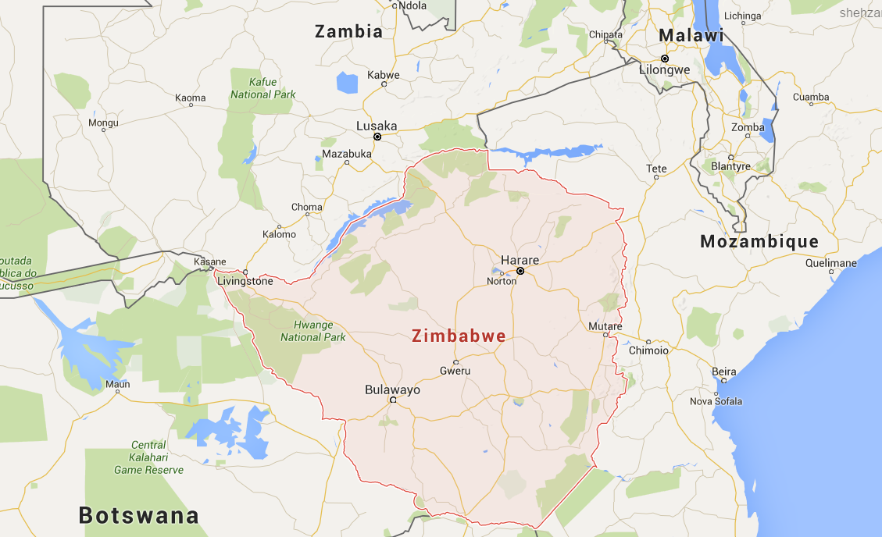
LOCATION OF SABI STAR
SABI STAR

Slide 4
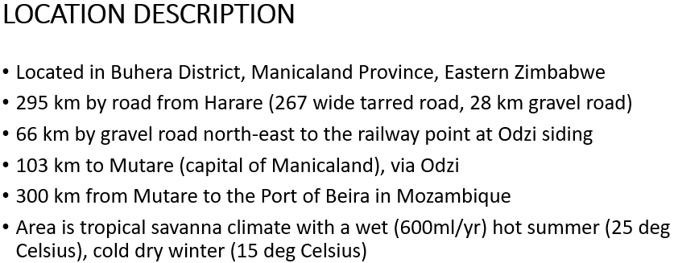
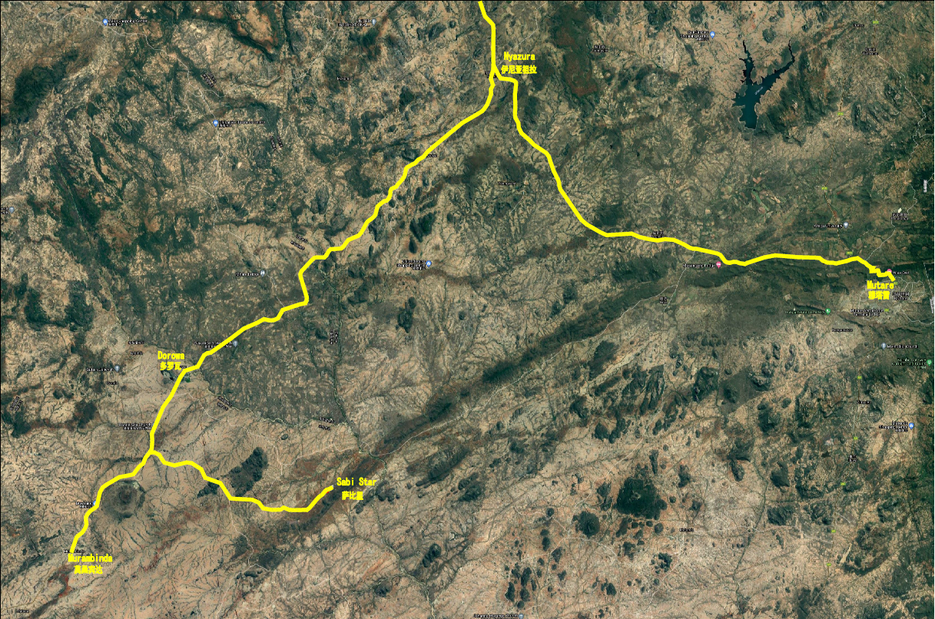
Nyazura
Odzi
Mutare
Dorowa
Gaza
Sabi Star
Murambinda

Slide 5
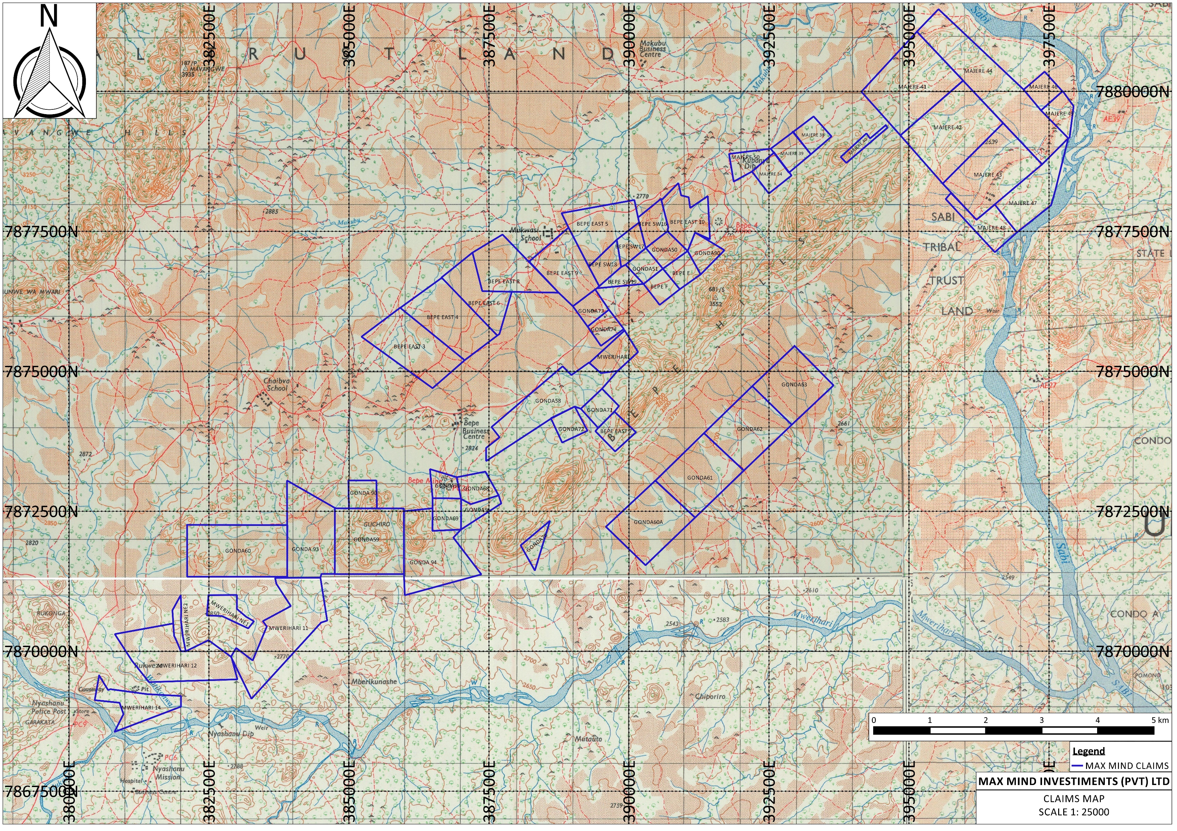
MUKWASI SCHOOL
SABI STAR
BHIDHIRI CENTRE
55 claims – 3832Ha

Slide 6
EXPLORATION & MINERAL RESOURCE DEVELOPMENT

Slide 7
MINERAL RESOURCE
Resource Classification | Tonnes | Main Mineral | By-Product Mineral
 |  | Li₂O (%) | Ta₂O₅ (g/t)
Measured Resource | 3,110,000 | 2.11 | 188.34
Indicated Resource | 648,000 | 1.79 | 205.13
Inferred Resource | 550,000 | 1.85 | 167.16
TOTAL | 4,308,000 | 2.03 | 188.16
Resource Classification | Tonnes | Main Mineral | By-Product Mineral
 |  | Ta₂O₅ (g/t) | Li₂O (%)
Meas+Ind+Inf Resource | 2,503,000 | 192.38 | 0.24
TOTAL | 2,503,000 | 192.38 | 0.24
A combined Mineral Resource of +/- 5 Million Tonnes at a cut-off grade of 1.86% Li2O.

Slide 8
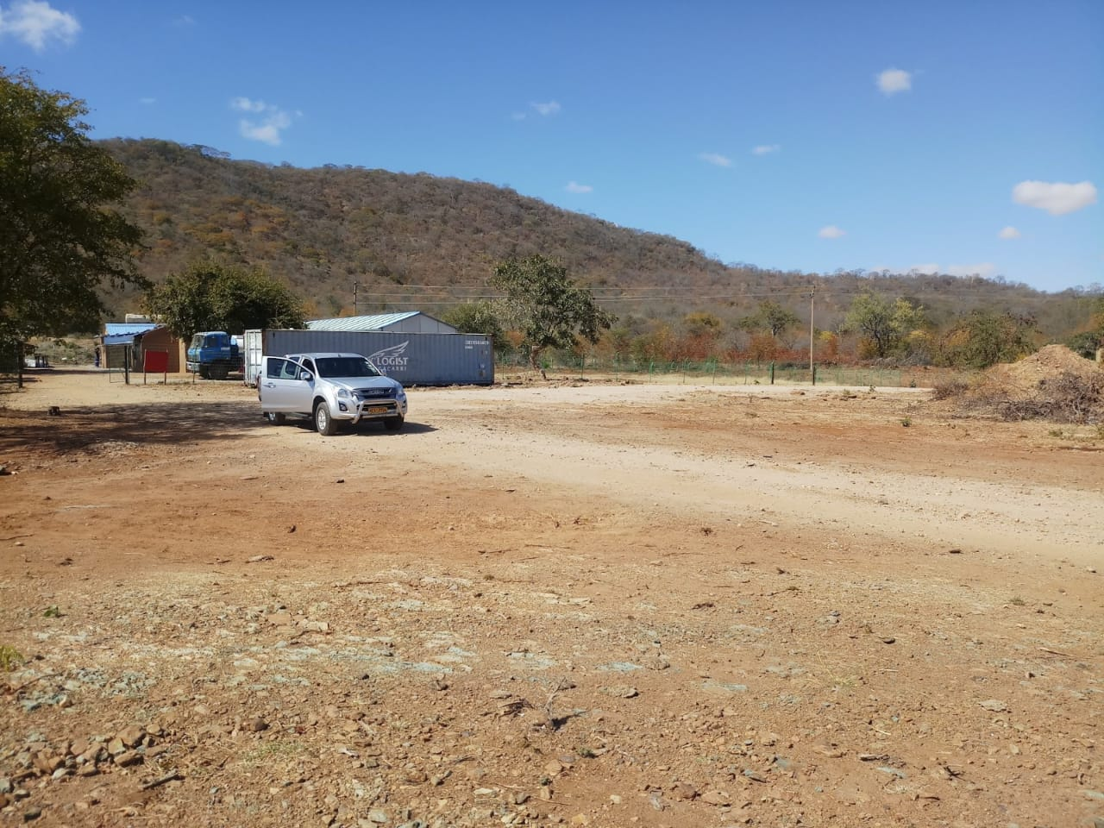
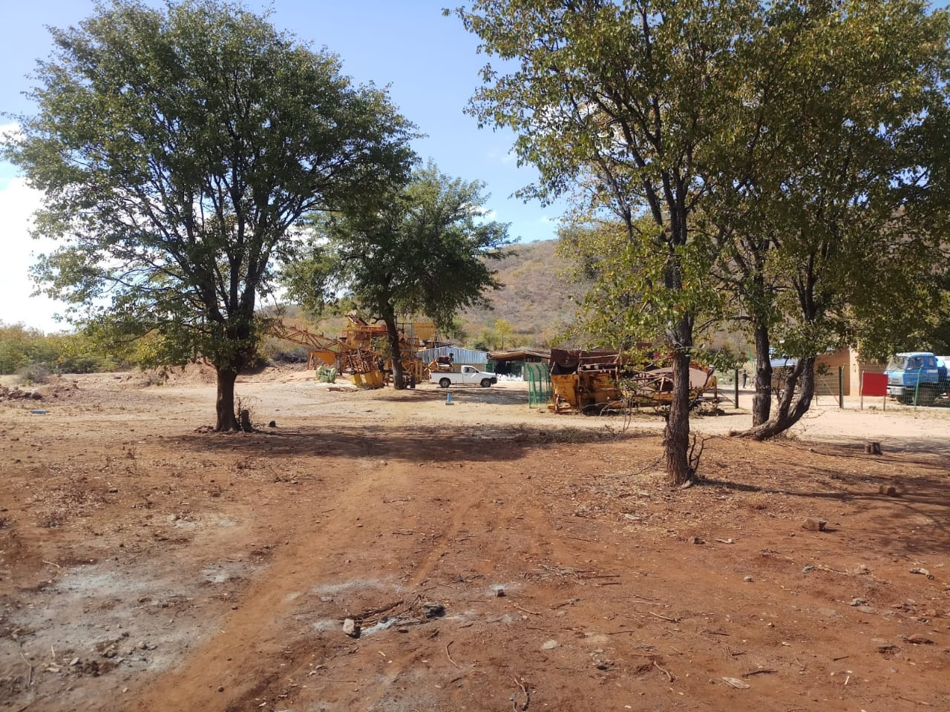
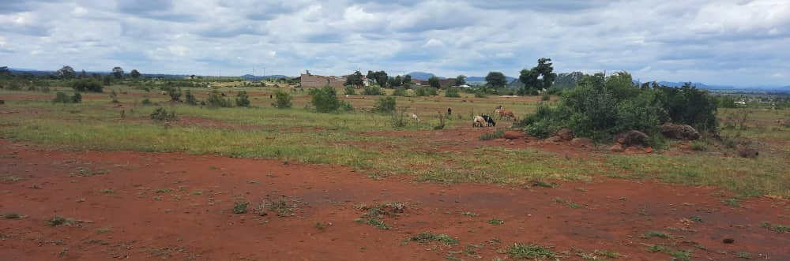
PROJECT DEVELOPMENT – APRIL 2022

Slide 9

PROJECT DEVELOPMENT – APRIL 2023
WE ARE ALMOST THERE

Slide 10
PROJECT DEVELOPMENT – PRODUCTIVITY
World-class mineral processing equipment
Ore processing capacity 1,000,000 tons per annum.
Li2O 6% lithium concentrate output estimation 300,000 tons per annum.
Extensive technical support from one of the top Chinese lithium beneficiation research institution to improve the recovery rate.

Slide 11
PROJECT DEVELOPMENT - BENEFITS
Employment creation as the project forecast to recruit over 400 employees at full production (85% local and 15%local). The bulk of the non-skilled employees will be from the immediate vicinity of the project.
Transfer of skills from expats to local employees through training and coaching of new technologies and equipment
Improvement of local infrastructure such as:
  Roads – upgrade of the Gaza-Sabi Star road will improve accessibility and open up the area to business
  Water (for people and livestock) – sinking of community boreholes will alleviate the current shortages
  Social amenities (clinic) – building of a clinic will benefit the local community as the current nearest clinic is 7km away. There are also plans to build and help schools when the mine is operational.
Foreign Currency generation through foreign direct investment and 100% export sales of the mineral concentrate.
Benefit to downstream businesses such as transport, local retail and local suppliers for mine consumables
Revenue generation for the Zimbabwean Government through taxes and royalties

Slide 12
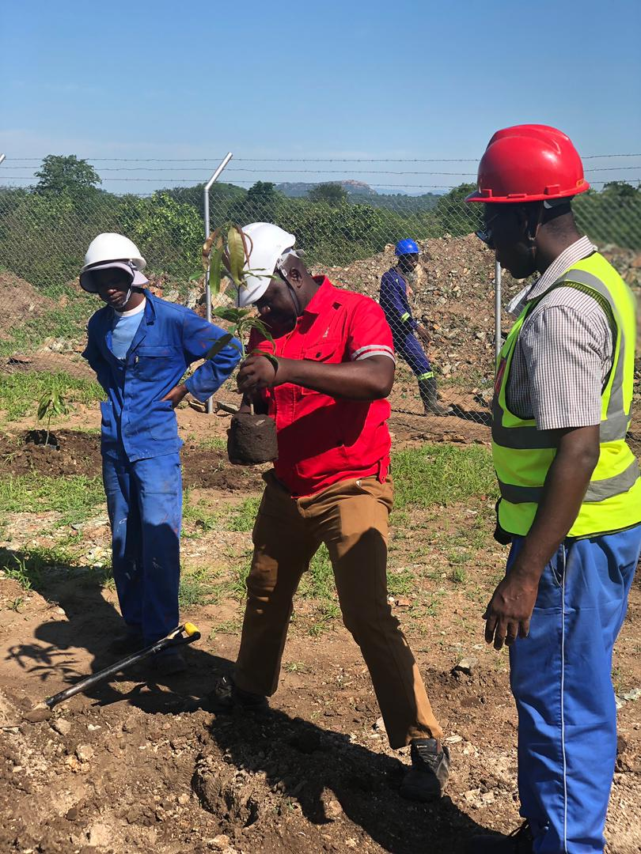
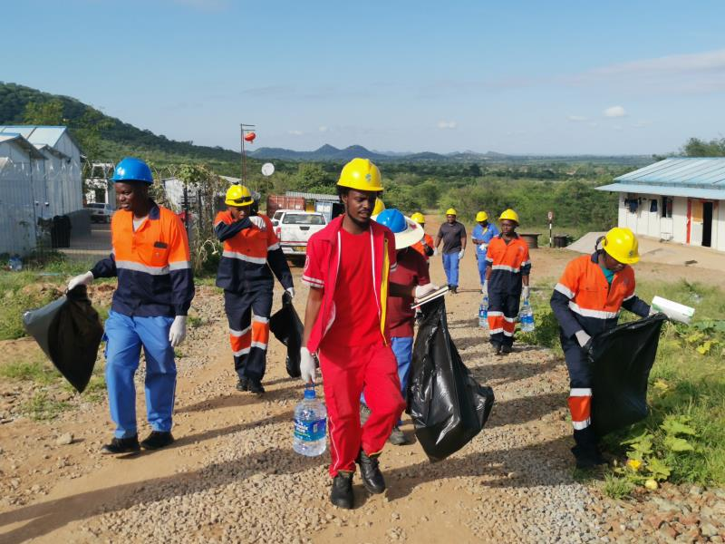
PROJECT DEVELOPMENT - ZERO HARM SHE POLICIES
We attach great importance to our responsibilities in health, safety and
environmental protection.
Strict environmental protection measures;
Environmental friendly and non-toxic beneficiation reagents are adopted in the production circuit;
Tailings water are recycled to form a close circuit to save water resources;
Zero exhaust gas;
High standard antiseepage tailings pond;
Negligible radioactivity level from the products and tailings, which are significantly lower than the regulated national limit standard for radioactive substances (GB6566-2010);
No hazardous wastes.
Energy saving and consumption reduction measures to be implemented according to design.
12

Slide 13
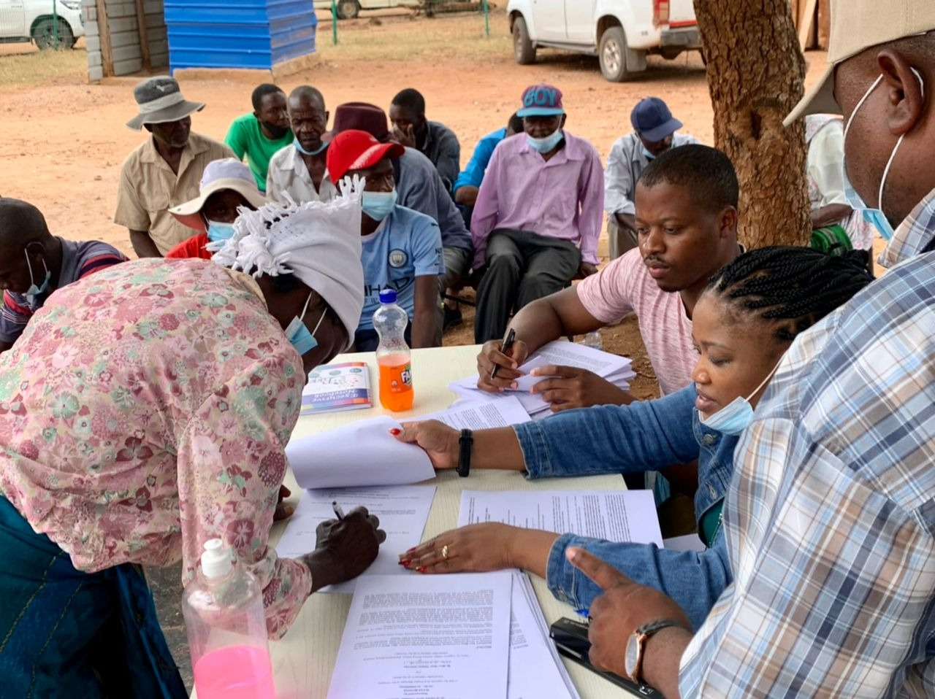
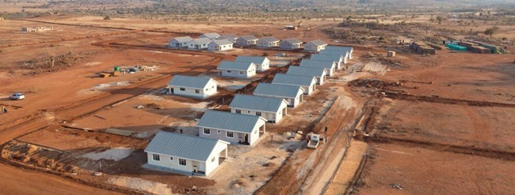
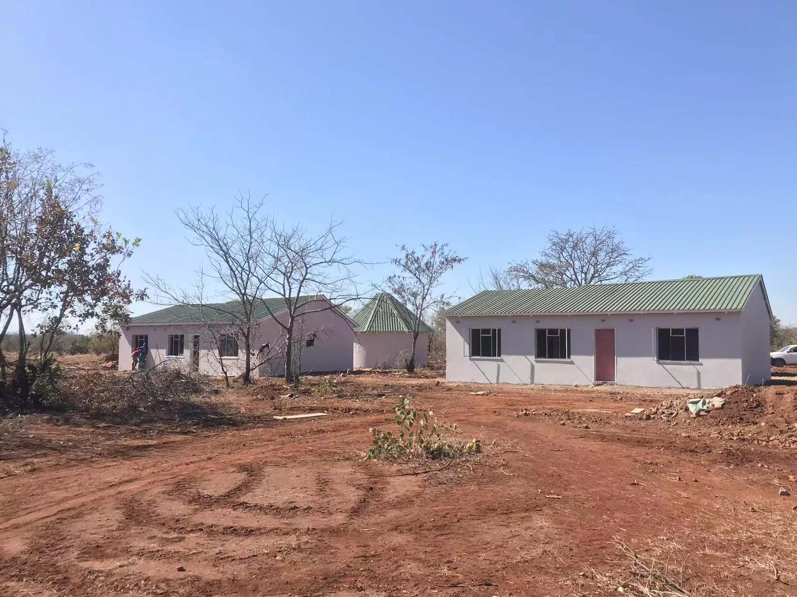
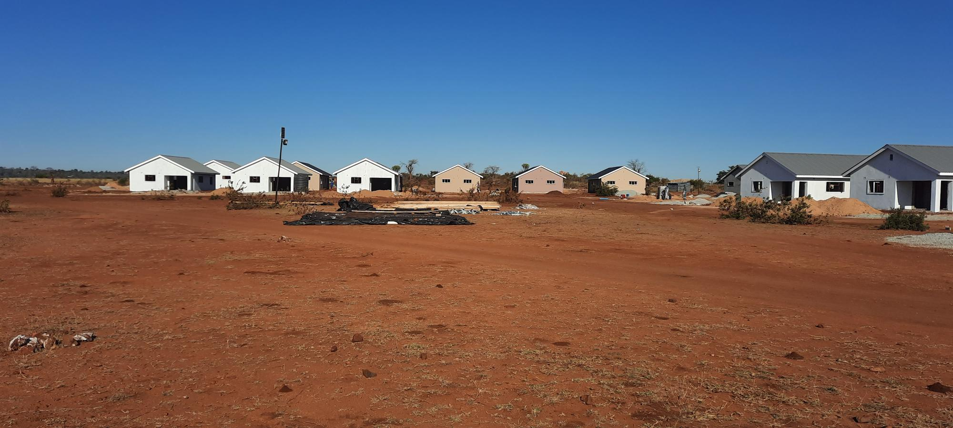
SOCIAL RESPONSIBILITIES
40 families have been relocated from Tagaria and Mukwasi villages in Buhera North to the locations of their own choices: 22 families opted to relocated to Murambinda township where the mine purchased 22 x 450m2 stands; 17 families opted to be relocated locally, and 1 family opted to go back to their ancestral land in Mberengwa.

Slide 14
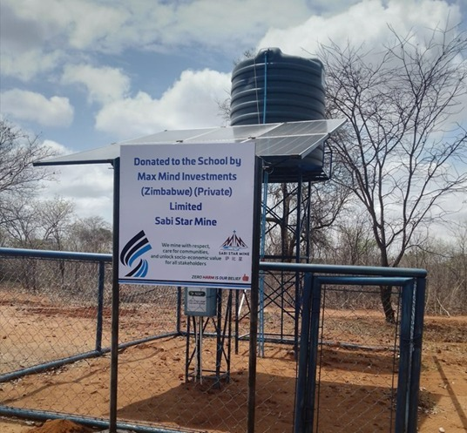
SOCIAL RESPONSIBILITIES (continued)
18 boreholes were drilled in the community equipped with solar pumps, among which 10 were drilled at the schools and 8 in the surrounding villages in consultation with the local leadership.

Slide 15
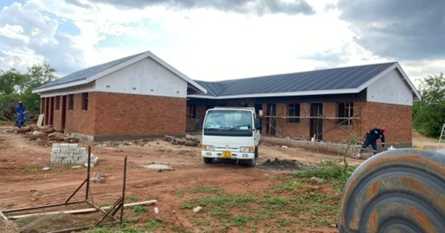
SOCIAL RESPONSIBILITIES (continued)
At least 9 schools in the community received paint and accessories from the mine and the painting was done by volunteers from the local community.
A clinic was constructed at Mukubu business centre to benefit the local community.

Slide 16
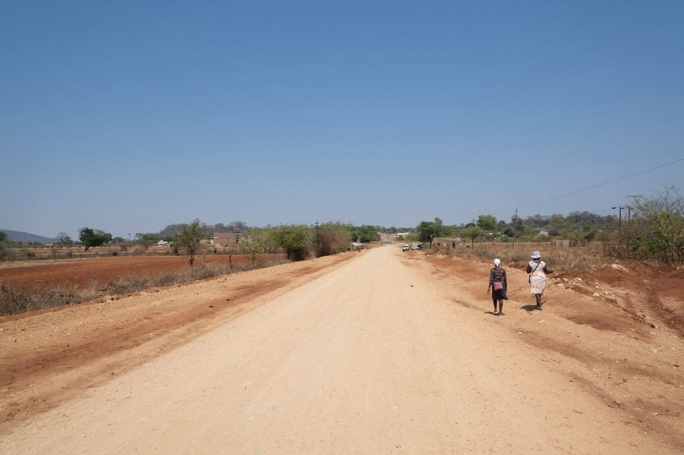
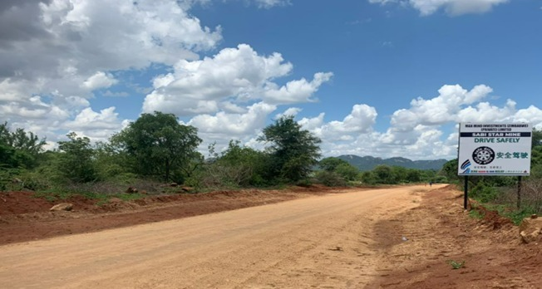
SOCIAL RESPONSIBILITIES (continued)
Upgraded the 30km access road from Gaza Business Centre to the mine, and other road in the community.

Slide 17
STRATEGIC VISION
Our vision: growing the lithium mining business in sync with the pronouncements by the Zimbabwean Government to add value to all local natural resources.
To be one of the first hard-rock large-scale lithium mining companies in Zimbabwe producing spodumene concentrate.
To grow the current mineral resource base through continued acquisition of mineral rights (claims) and further exploration.
To upgrade spodumene concentrate to battery-grade lithium carbonate and hydroxide through a lithium salt plant as a mid to long term goal.
Further value addition to produce lithium batteries is a longer term vision for Max Mind. Currently this vision is hindered by the limited infrastructure available locally, and lack of sufficient lithium resource on the current mining claims.

Slide 18
CHALLENGES AND OPPORTUNITIES
Challenges
Fluctuations in the market and slump of the lithium price
The trend of higher supply than demand
Logistics bottleneck
Insufficient infrastructure and skill
Lack of understanding and support
Opportunities
Adjustment of the price by the market
Create dialogues and communications between the mining companies, the mining community and the government authority to enhance knowledge and understanding
Learning curve for all
Value addition is the future

Slide 19
MAX MIND INVESTMENTS ZIMBABWE - APPRECIATION
Thank you for your dedicated support on our project.

