Slide 1
European CRM Act
Proposal for a Regulation - establishing a framework for ensuring a secure and sustainable supply of critical raw materials
Elisabetta Sartorel, 31/05/2023

Slide 2
European Critical Raw Materials Act
Ensuring a secure and sustainable supply
of critical raw materials for the EU
Improve EU capacity to monitor and mitigate risks of disruption to CRM supply
Strengthen all stages of the European CRM value chain
Diversify EU CRM imports to reduce strategic dependencies
Improve CRM circularity and sustainability

Slide 3
EU Strategic Partnerships
Key aspect of the external dimension of the CRM Act – the EU commits to develop mutually beneficial strategic international partnerships on sustainable raw materials value chains to support investments and secure a diversified and sustainable supply of critical raw materials
The format of these partnerships consist of a bilateral Memorandum of Understanding reaffirming both sides interest and a Roadmap detailing concrete actions to support the creation and integration of sustainable raw materials value chains.

Slide 4
EU Strategic Partnerships on Raw Materials
GREENLAND
NORWAY
CANADA
UKRAINE
KAZAKHSTAN
DRC
GREAT LAKES
Partnerships signed
Partnerships in the pipeline
NAMIBIA
AUSTRALIA
Partnerships announced
CHILE
ARGENTINA
DG GROW 15/03/2023

Slide 5
Partnerships with emerging economies and developing countries
A driver for structural transformation
Based on mutual benefits and with a holistic approach, key is local value addition in partner country
Covering the entire raw materials value chain (exploration, extraction, processing, refining, recycling)
Structured along five axes:
Integration of (critical) raw materials value chains (the business-oriented pillar)
Cooperation on research and innovation
Alignment on Environmental, Social, and Governance (ESG) Criteria and international standards
Deployment of infrastructure for projects development
Capacity Building, training and skills along raw materials value chain
All these efforts are supported in the framework of the Global Gateway strategy in a Team Europe approach

Slide 6
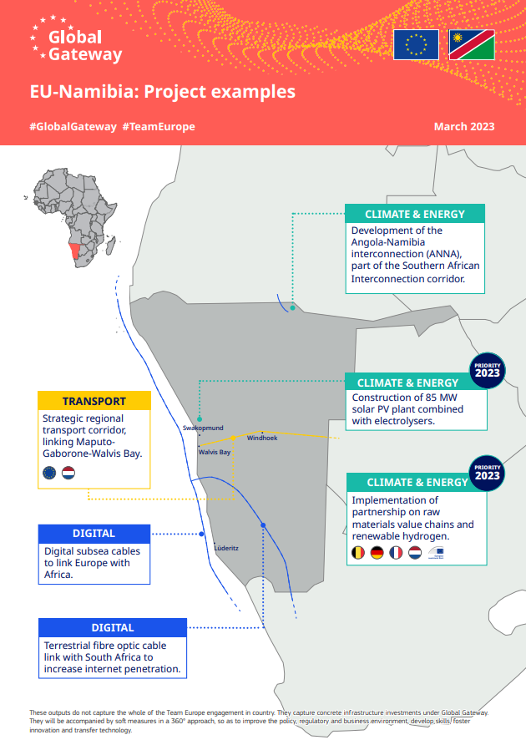
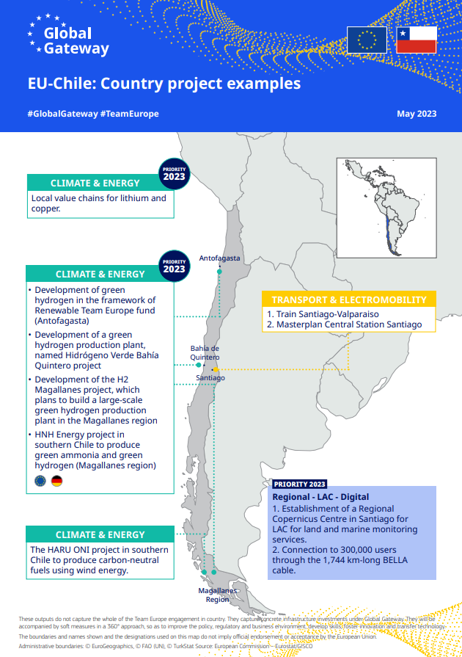

Slide 7
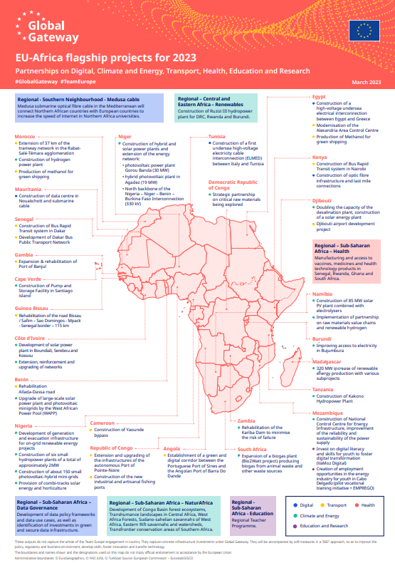
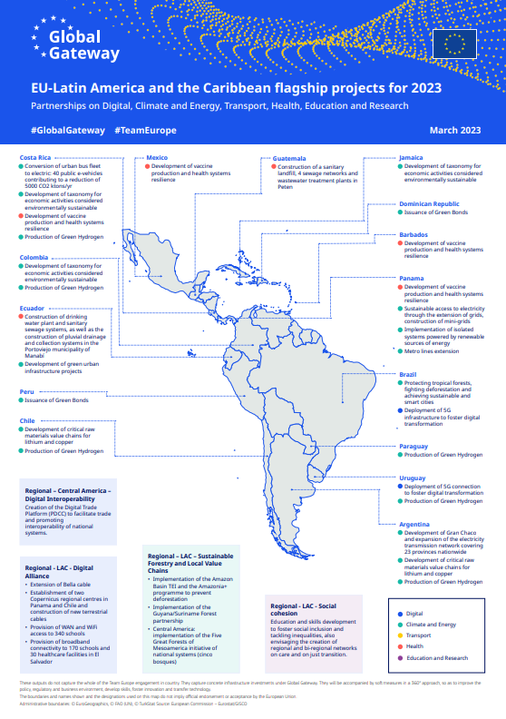

Slide 8
Global Gateway as a delivery mechanism
Activities supported under Global Gateway can include:
Facilitate networking amongst all relevant actors of the raw materials value chains
Leverage sustainable private sector investments
Support exploration programmes
Provide education and training programmes
Alignment with international standards and ESG criteria (e.g. support to EITI)
Infrastructure development
Improvement of investment climate and business environment
Capacity building for regulatory frameworks
Renewable energy production including green hydrogen
Notes:
The EU currently has several programmes aimed to promote transparency, good governance and responsible mining practices in the extractives sector. This will also help towards creating a level playing field for EU companies.
Examples include:
the Extractive Industries Transparency Initiative (EITI) whose standard has been adopted by 57 implementing countries to date (of which several LATAM countries);
the G7 CONNEX Initiative, which provides qualified technical assistance to developing countries and emerging economies in negotiating complex mining contracts;
the European Partnerships for Responsible Minerals (EPRM), to accompany the implementation of EU Regulation 2017/821 that imposes due diligence obligations on EU importers of Tin, Tungsten Tantalum and Gold (3TGs)
the UNDP ACP-EU Development Minerals programme, focusing in particular on the formalisation and capacity building of artisanal and small-scale mining sector (ASM).

Slide 9
Useful Links
CRM Act Press Release
CRM Act (Draft Regulation)
CRM Act (Communication)
2023 JRC Foresight Study
2023 Study on CRMs for the EU
CRM Factsheets

Slide 10
Thank you!
Elisabetta.SARTOREL@ec.europa.eu

