Slide 1
Minerals Security Partnership
Nicole Johnson
U.S. Embassy Zimbabwe

Slide 2
MSP PARTNERS

Slide 3
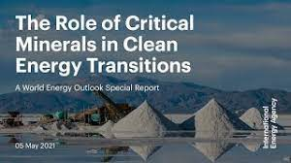
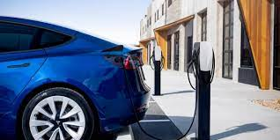
CONTEXT

Slide 4
OBJECTIVES
Promote Diverse, Secure, Transparent Supply Chains
Help Countries Realize Full Economic Development Benefits
Catalyze Investment
Elevate ESG Standards: Race to the Top

Slide 5
LINES OF EFFORT
Information Sharing
Promoting Investment and Financing
Adopting High ESG Standards
Expanding Offtake and Recycling Opportunities

Slide 6
MSP PARTNERS STATEMENT
Principles for MSP Projects
Responsible Environmental Stewardship
Consultative and participatory processes for land access
Transparent communication with communities
Safe, fair, inclusive, and ethical conditions
Economic benefit
Transparent, ethical business operations

Slide 7
THANK YOU
Nicole Johnson
JohnsonNG@state.gov

